Slide 1
Transformers Introduction and BART

Slide 2
Outline
Introduction of Transformer
BartPho

Slide 3
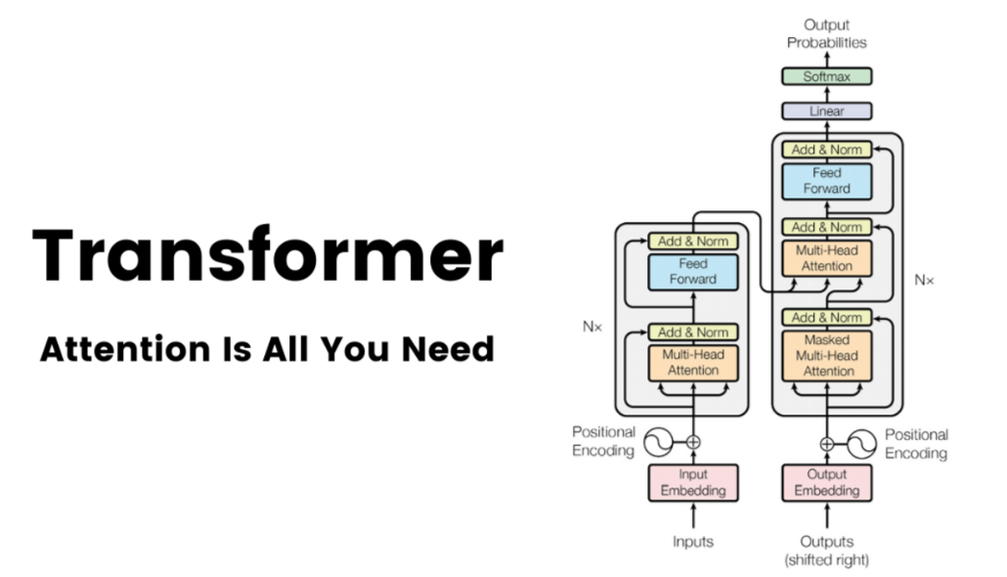
Introduction of Transformers
Transformers are a type of neural network that employ attention-based encoder-decoder type architecture and were introduced in the paper “Attention Is All You Need”.
Like LSTM, Transformer is an architecture for transforming one sequence into another one with the help of two parts (Encoder and Decoder), it does not use any RNNS (LSTM, GRU etc).

Slide 4
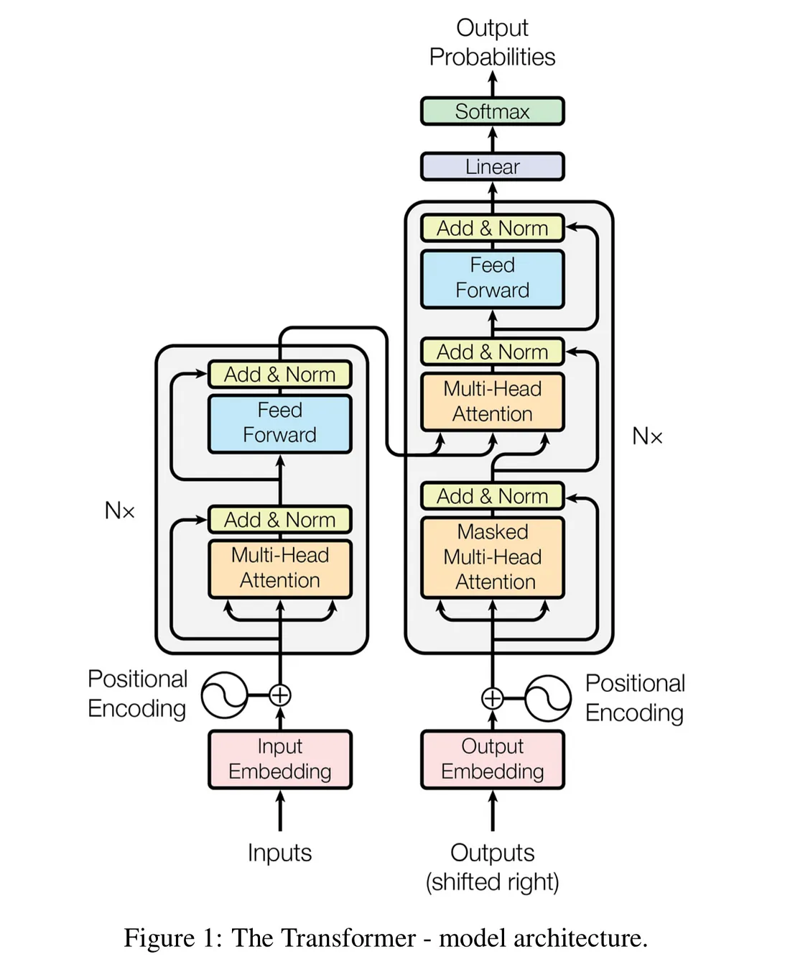
Transformers Architecture
Transformers consist of Encoder and Decoder. Both Encoder and Decoder are composed of modules that can be stacked on top of each other multiple times, which is described by Nx in the figure. The modules consists of mostly Multi-Head Attention and Feed Forward layers.
The Encoder maps an input sequence into an abstract continuous representation that holds all the learned information of that input. The Decoder then takes that continuous representation and step by step generates a single output while also being fed the previous output.

Slide 5
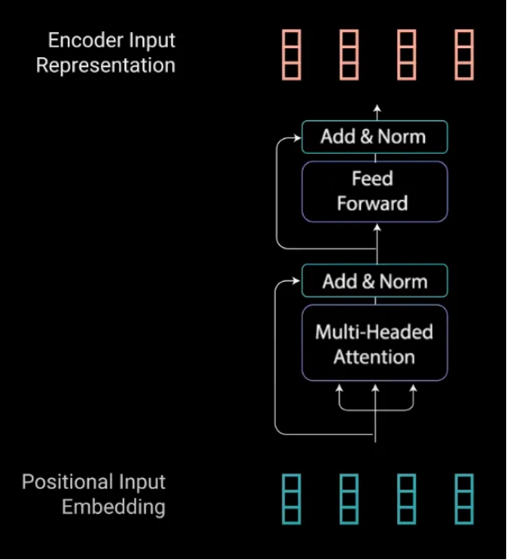
Encoder layer
The Encoders layers job is to map all input sequences into an abstract continuous representation that holds the learned information for that entire sequence.
It contains 2 sub-modules, multi-headed attention, followed by a fully connected network.

Slide 6
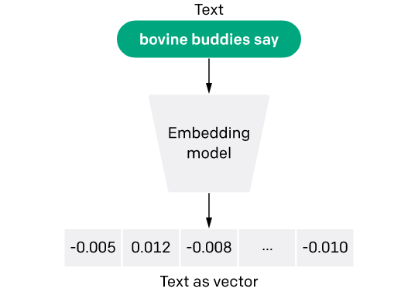
Input Embeddings
The first step is to feeding inputs into a word embedding layer to grab a learned vector for each word in the input sequence.
Because neural networks can only learn through number each word must be mapped to a vector of continuous values to represent that word.

Slide 7
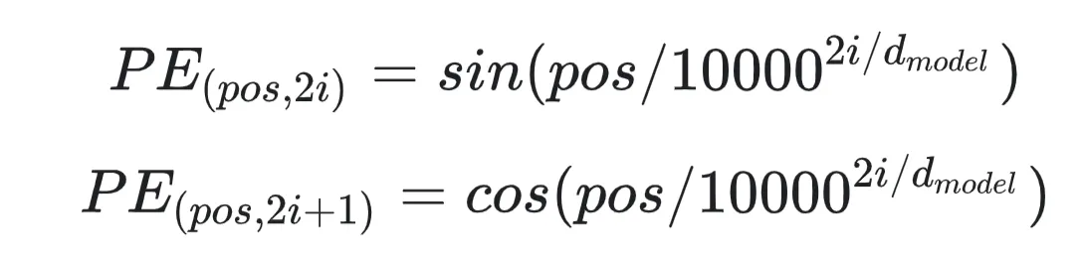
Positional Encoding
The next step is to inject positional information into the embeddings. Because the transformer encoder has no recurrence like recurrent neural networks, we need to somehow give every word/part in our sequence a relative position since a sequence depends on the order of its elements
For every odd index on the input vector, create a vector using the cos function. For every even index, create a vector using the sin function. Then add those vectors to their corresponding input embeddings. This successfully gives the network information on the position of each vector

Slide 8
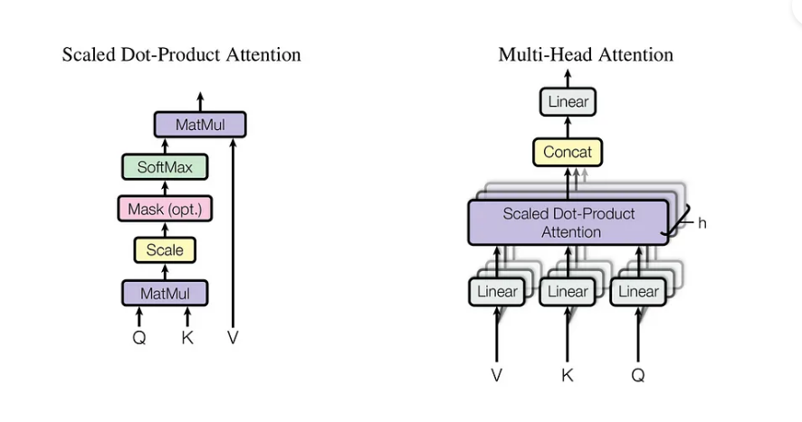
Multi-Headed Attention
Multi-headed attention in the encoder applies a specific attention mechanism called self-attention. Self-attention allows the models to associate each word in the input.

Slide 9
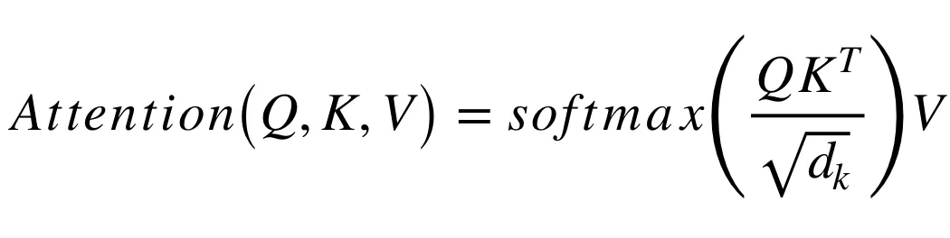
Query, Key, and Value Vectors
Q is a matrix that contains the query (vector representation of one word in the sequence), K are all the keys (vector representations of all the words in the sequence) and V are the values, which are again the vector representations of all the words in the sequence.

Slide 10
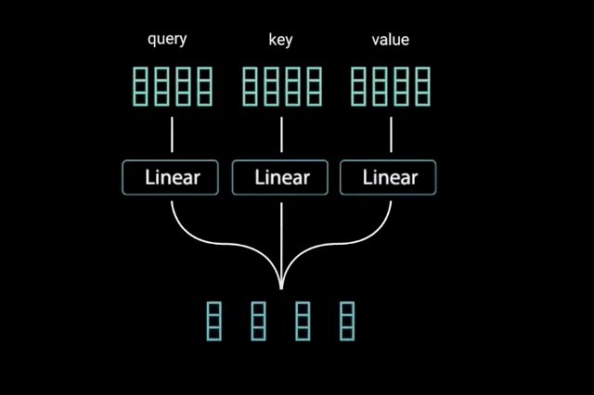
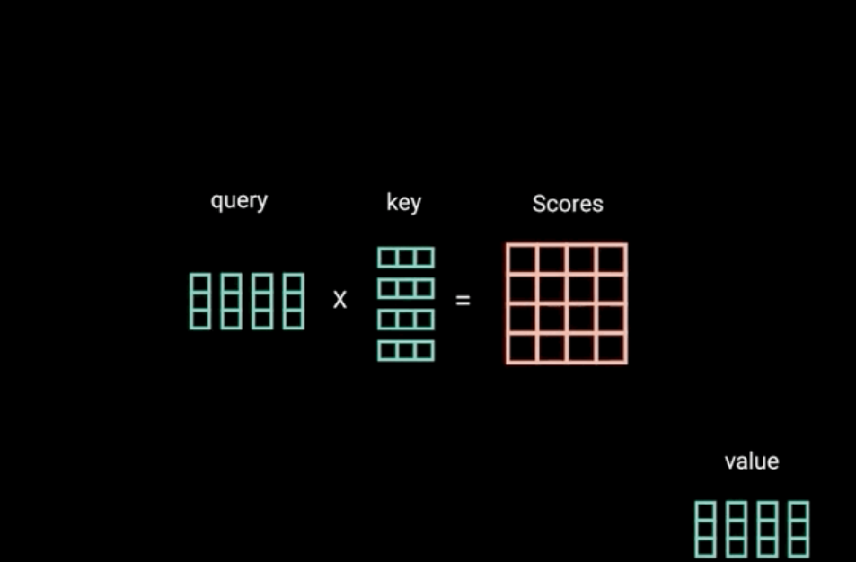
Dot Product of Query and Key
After feeding the query, key, and value vector through a linear layer, the queries and keys undergo a dot product matrix multiplication to produce a score matrix.

Slide 11
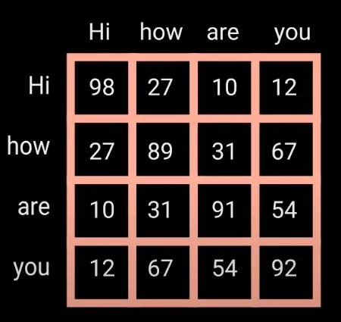
The score matrix determines how much focus should a word be put on other words. So each word will have a score that corresponds to other words in the time-step. The higher the score the more focus

Slide 12
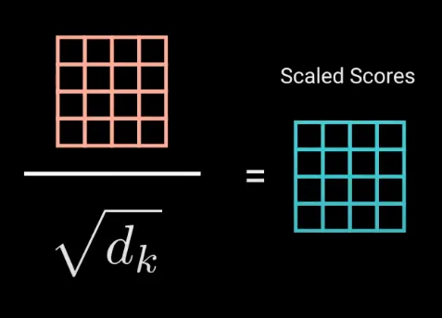
Scaling Down the Attention Scores
Then, the scores get scaled down by getting divided by the square root of the dimension of query and key. This is to allow for more stable gradients, as multiplying values can have exploding effects

Slide 13
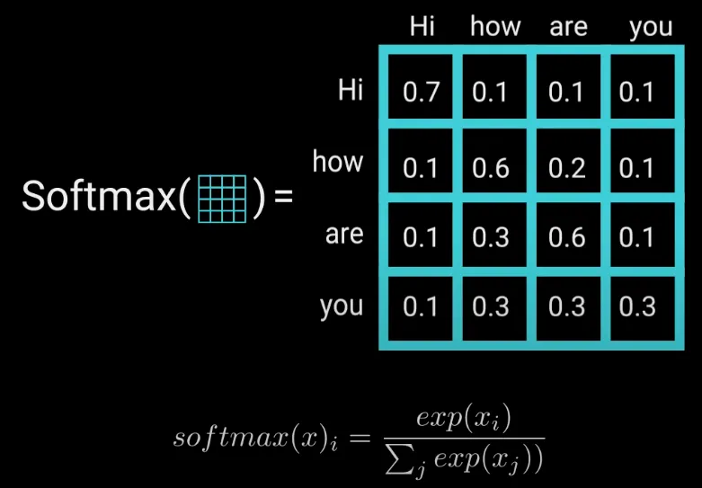
Softmax of the Scaled Scores
Next, you take the softmax of the scaled score to get the attention weights, which gives you probability values between 0 and 1. This allows the model to be more confident about which words to attend too

Slide 14
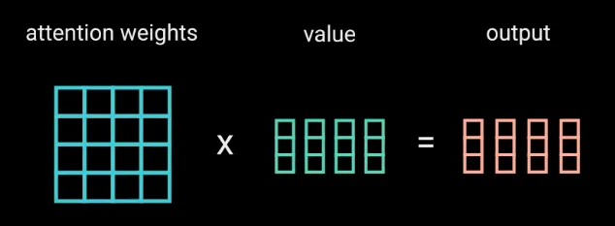
Multiply Softmax Output with Value vector
And finally, take the attention weights and multiply it by value vector to get an output vector. The higher softmax scores will keep the value of words the model learns is more important. The lower scores will drown out the irrelevant words. Then feed the output of that into a linear layer to process.

Slide 15
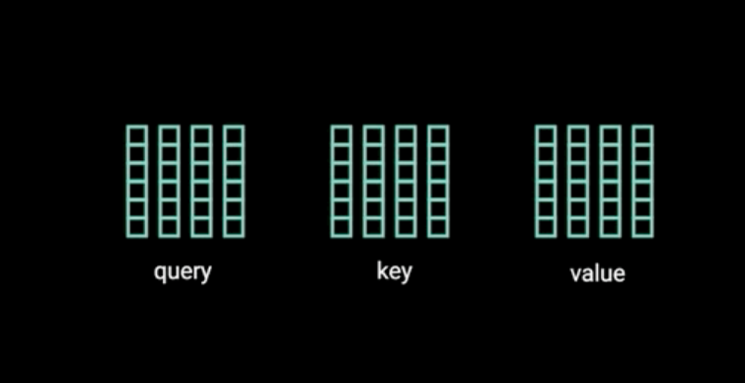
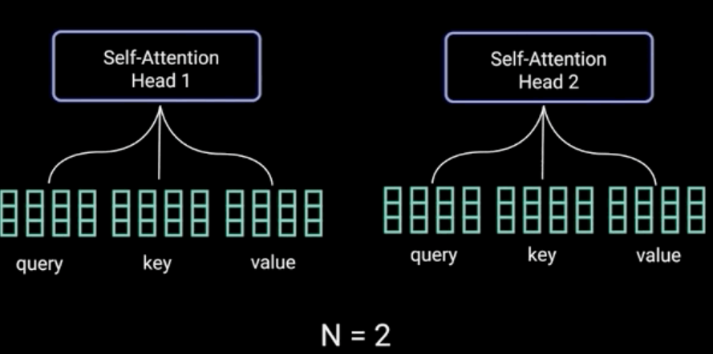
Computing Multi-headed Attention
To make this a multi-headed attention computation, split the query, key, and value into N vectors before applying self-attention. The split vectors then go through the self-attention process individually. Each self-attention process is called a head. Each head produces an output vector that gets concatenated into a single vector before going through the final linear layer

Slide 16
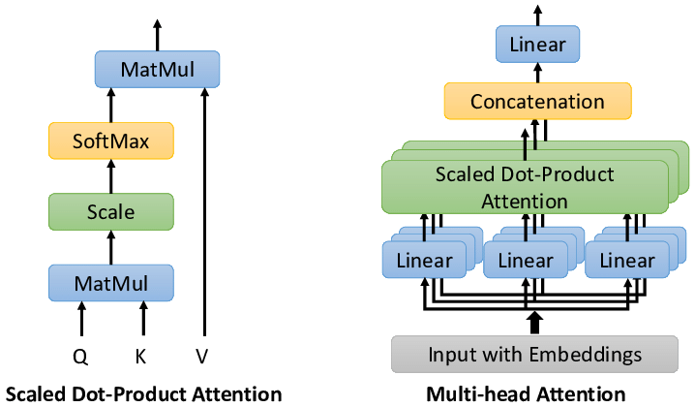
Multi-headed Attention
To sum it up, multi-headed attention is a module in the transformer network that computes the attention weights for the input and produces an output vector with encoded information on how each word should attend to all other words in the sequence.

Slide 17
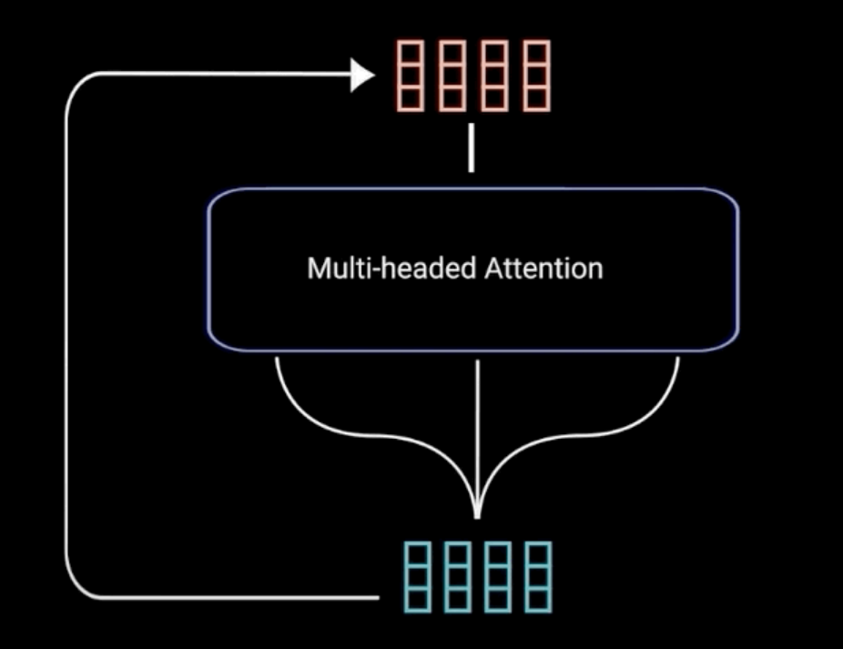
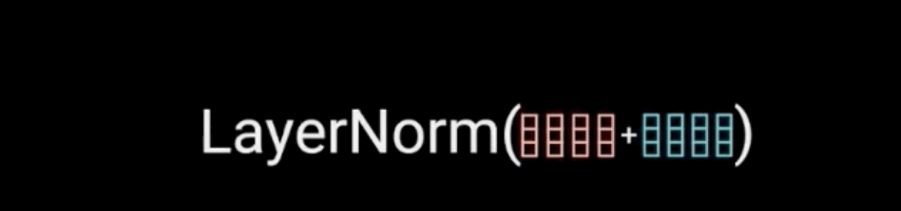
Add & Norm
The multi-headed attention output vector is added to the original positional input embedding. This is called a residual connection. The output of the residual connection goes through a layer normalization.

Slide 18
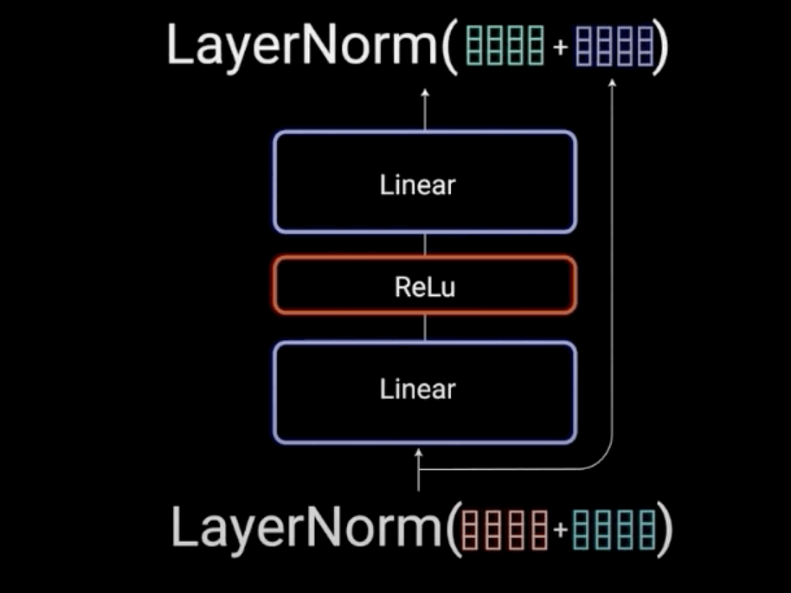
FeedForward & Add & Norm
The normalized residual output gets projected through a pointwise feed-forward network for further processing.
The pointwise feed-forward network is a couple of linear layers with a ReLU activation in between. The output of that is then again added to the input of the pointwise feed-forward network and further normalized.

Slide 19
Encoder Sum up
The residual connections help the network train, by allowing gradients to flow through the networks directly. The layer normalizations are used to stabilize the network which results in substantially reducing the training time necessary. The pointwise feedforward layer is used to project the attention outputs potentially giving it a richer representation.
All of these operations are to encode the input to a continuous representation with attention information. This will help the decoder focus on the appropriate words in the input during the decoding process. One can stack the encoder N times to further encode the information, where each layer has the opportunity to learn different attention representations

Slide 20
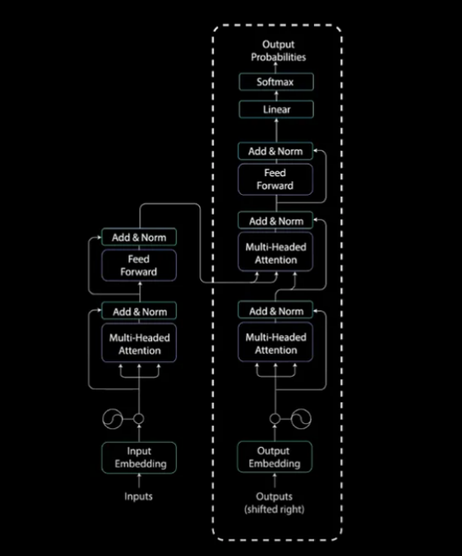
Decoder layer
The decoder has a similar sub-layer as the encoder. it has two multi-headed attention layers, a pointwise feed-forward layer, and residual connections, and layer normalization after each sub-layer. These sub-layers behave similarly to the layers in the encoder but each multi-headed attention layer has a different job.

Slide 21
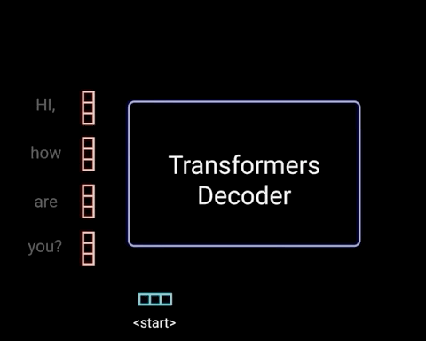
Decoders First Multi-Headed Attention
Since the decoder is autoregressive (it begins with a start token, and it takes in a list of previous outputs as inputs, as well as the encoder outputs that contain the attention information from the input). The decoder stops decoding when it generates a token as an output.

Slide 22
Decorders First Multi-Headed Attention Cont.
Since the decoder generates word by word, it shouldn’t be allowed to gain access the next word which it tries to predict. For example, in the sentence output “I am fine.”. When computing attention score for the word “am”, it can only attend to the previous word “I”. For this problem a method called “masking” can be used to prevent it, by “masking” future words to be predicted.

Slide 23
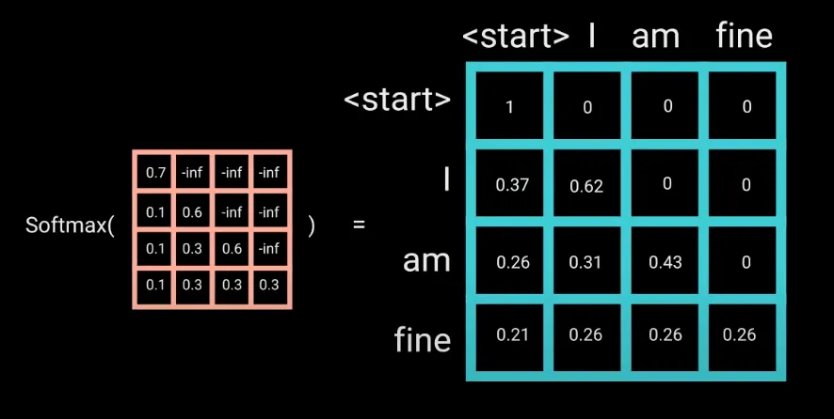
Masking future words
The look-ahead mask is just a matrix same size with the attention matrix filled 0 and inf values. Adding the mask with the scaled scores to get the masked scores, which then go through the softmax layer. Afterwards, all the inf values will be zeroed out, future tokens will have zero attention scores.

Slide 24
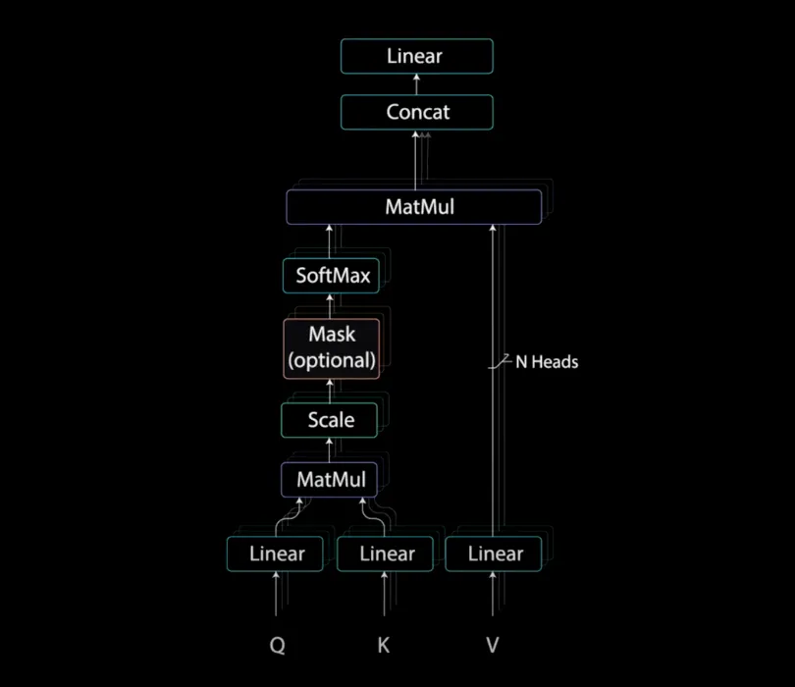
The output of the first multi-headed attention is a masked output vector with information on how the model should attend on the decoder’s input.

Slide 25
Decoders Second Multi-Headed Attention
For this layer, the encoder’s outputs are the queries and the keys, and the first multi-headed attention layer outputs are the values. This process matches the encoder’s input to the decoder’s input, The output of the second multi-headed attention goes through a pointwise feedforward layer.
The output of the classifier then gets fed into a softmax layer, which will produce probability scores between 0 and 1. We take the index of the highest probability score, and that equals our predicted word.

Slide 26
2. BART
Introduction to BART:
BART, a denoising autoencoder for pretraining sequence-to-sequence models.
BART is trained by:
Corrupting text with an arbitrary noising function
Learning a model to reconstruct the original text.
It uses a standard Tranformer-based neural machine translation architecture and combines Bidirectional and Auto-Regressive Transformers.

Slide 27
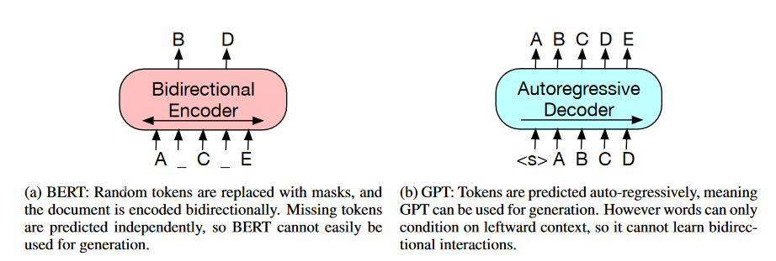
2. BART
Bidirectional Encoder from BERT and Autoregressive decoder from GPT

Slide 28
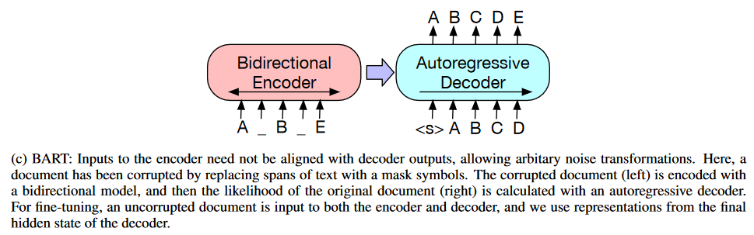
2. BART
Combine both encoder and decoder to create BART

Slide 29
2. BART
BART architecture:
This model uses standard seq2seq Transformer except, following GPT, that we modify ReLU activation functions to GeLUs.
For base model, 6 layers of encoder decoder is applied. And for large model this increases to 12 layers.

Slide 30
2. BART
BART architecture:
The architecture is closely related to that used in BERT, with the following differences: each layer of the decoder additionally performs cross-attention over the final hidden layer of the encoder (as in the transformer sequence-to-sequence model); and BERT uses an additional feed-forward network before word prediction, which BART omitted it.

Slide 31
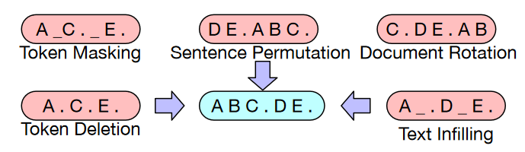
2. BART
BART is trained by corrupting documents and then optimizing a reconstruction loss—the cross-entropy between the decoder’s output and the original document.

Slide 32
2. BART
Corrupting documents refers to the task of modifying original documents, there are some corrupting documents tasks:
Token Masking: random tokens are replaced with mask tokens.
Token Deletion: delete some tokens.
Text Infilling: group of words are replaced with mask.
Sentence Permutation: doc is sentenced then shuffled.
Document Rotation: choose a random token and doc is rotated and start with that token

Slide 33
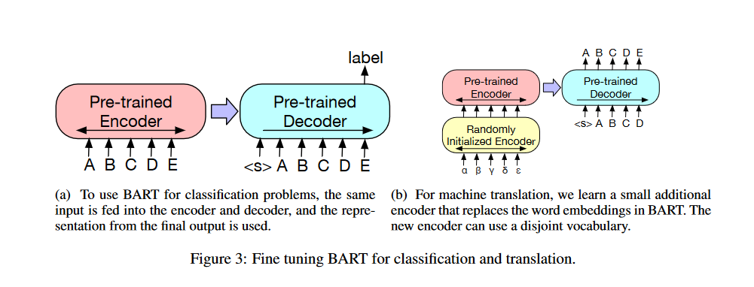
2. BART
Fine-tunning

